Slide 1


TD Construction
The website that caused me stress and pain.

Slide 2
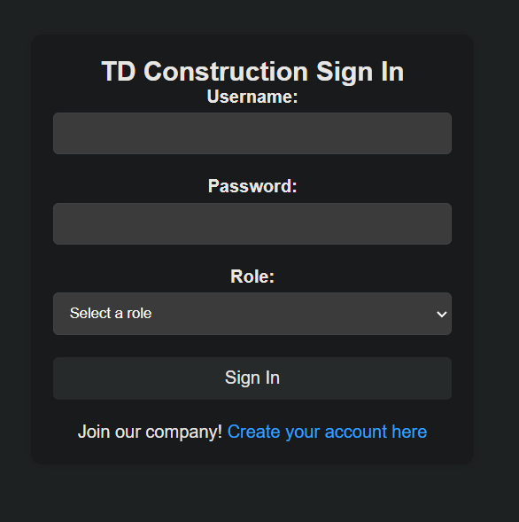
Index.html
Here you can sign into your account. Make sure to remember your username and password! Select your correct role, otherwise it won’t let you sign in. If you don’t have an account, you can easily make one.
Now hurry up, there’s construction stuff to do!

Slide 3
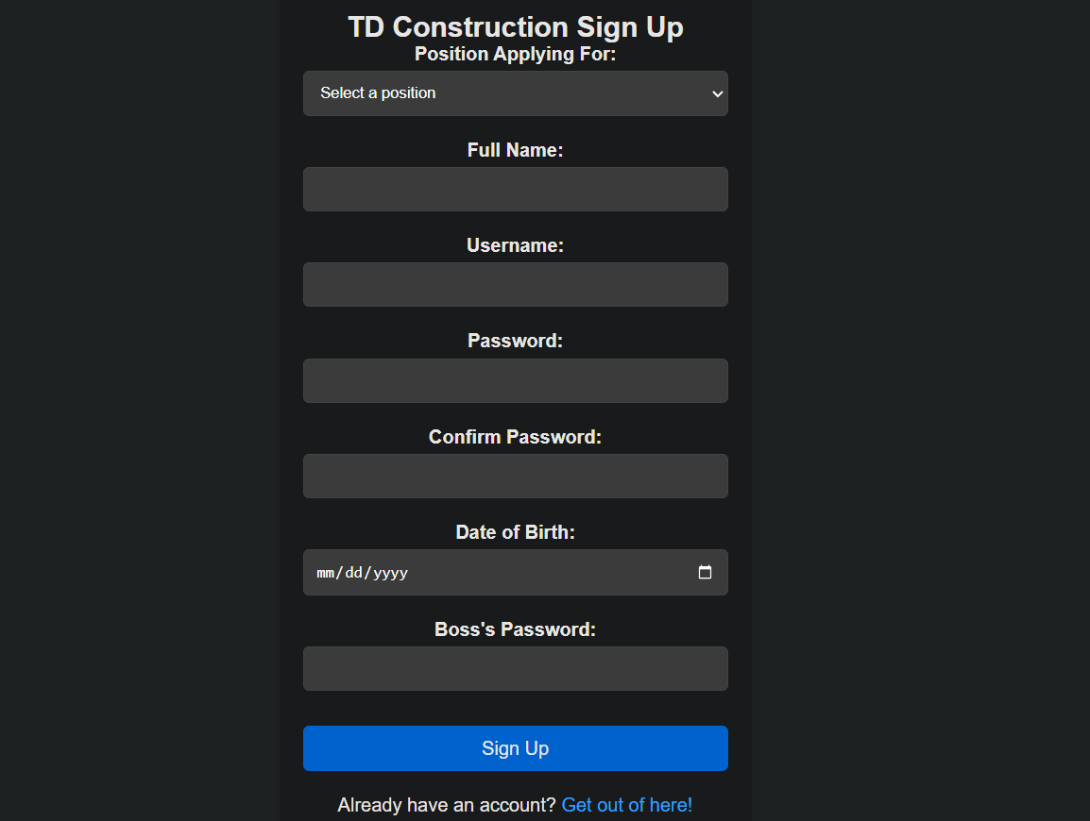
Signup.html
Here you can choose between registering as an employee, supervisor, or administrator. You’ll need The Boss’s approval though. Once you’re signed up, you’ll be sent back to the login page to sign in.
Man, you’ve already wasted so much time, we could’ve been pouring concrete already.

Slide 4
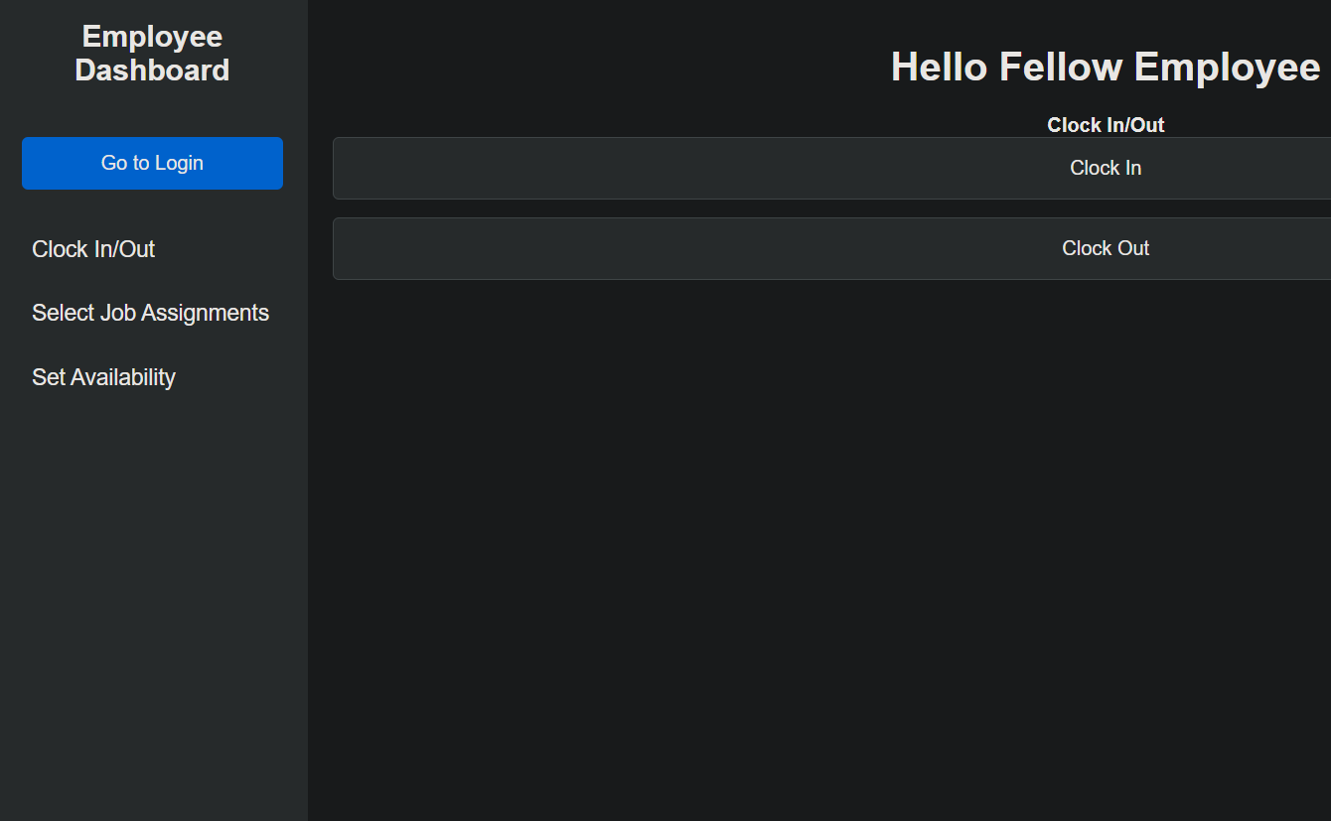
Employee.php
Hello fellow employee. Here you can clock in and clock out, select what job(s) you want to do for the day, and change your availability.
We’ve given you so much leeway, don’t make us regret it.

Slide 5
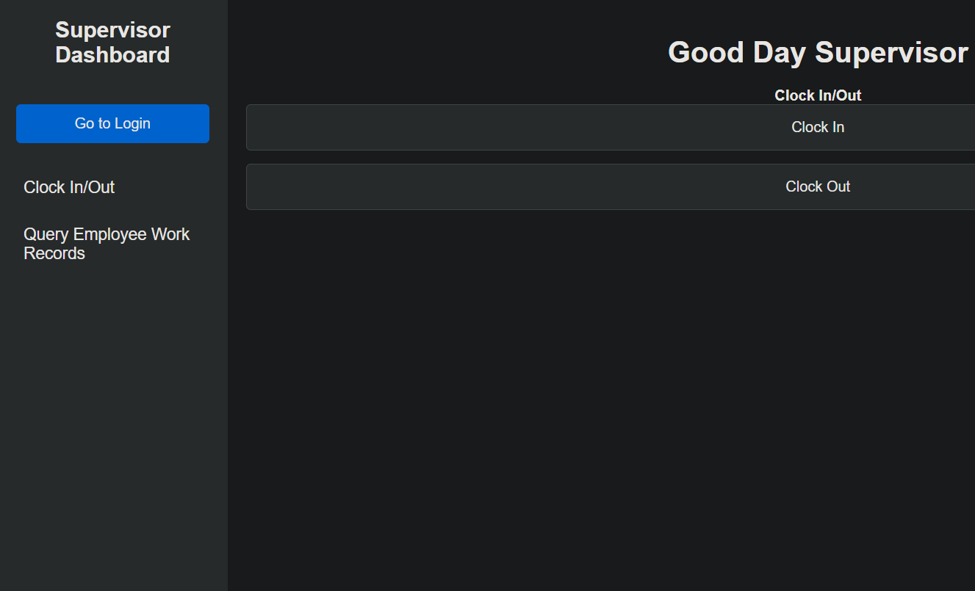
Supervisor.php
Good day supervisor. Here you can clock in and clock out, and also make sure your employees are doing what they say they’re doing. It shows you when an employee clocked in and out, their job assignments, and their availability.
One final note, if you hate your employees go talk to an administrator, they can help remove your problems. Somewhat permanently.

Slide 6
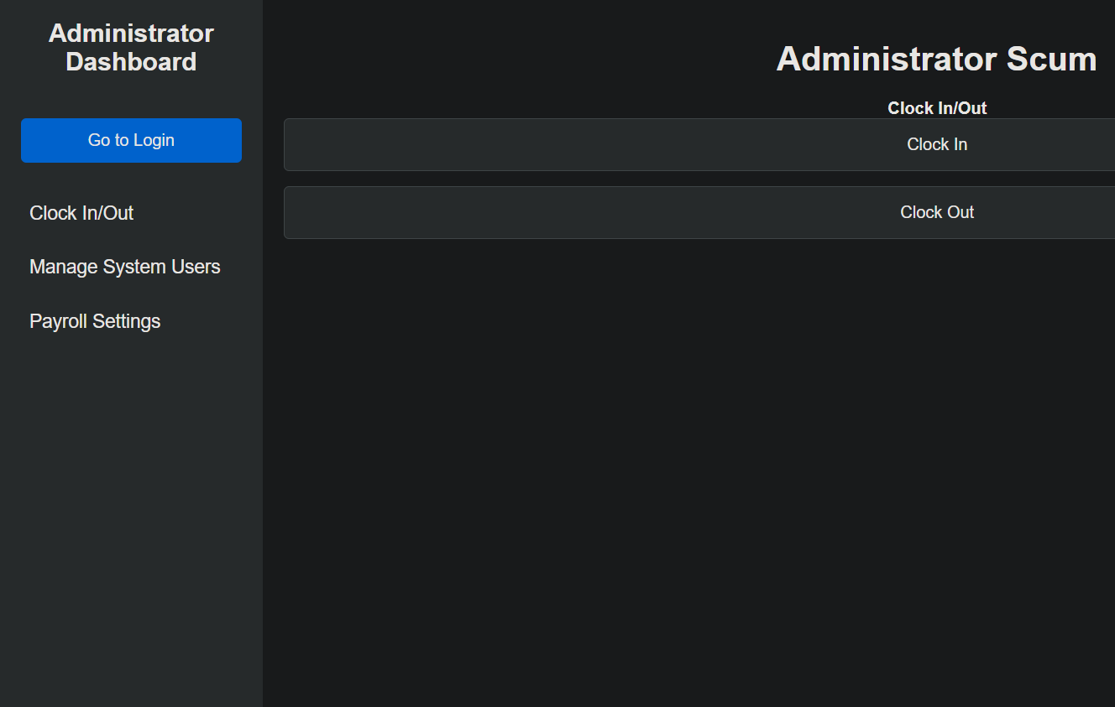
Administrator.php
Administrator scum! Get out of here! As an administrator you can clock in and out, manage system users (by deleting them), and change how much everyone gets paid, including yourself.
If you abuse this power The Boss will get very angry, so be careful.

Slide 7

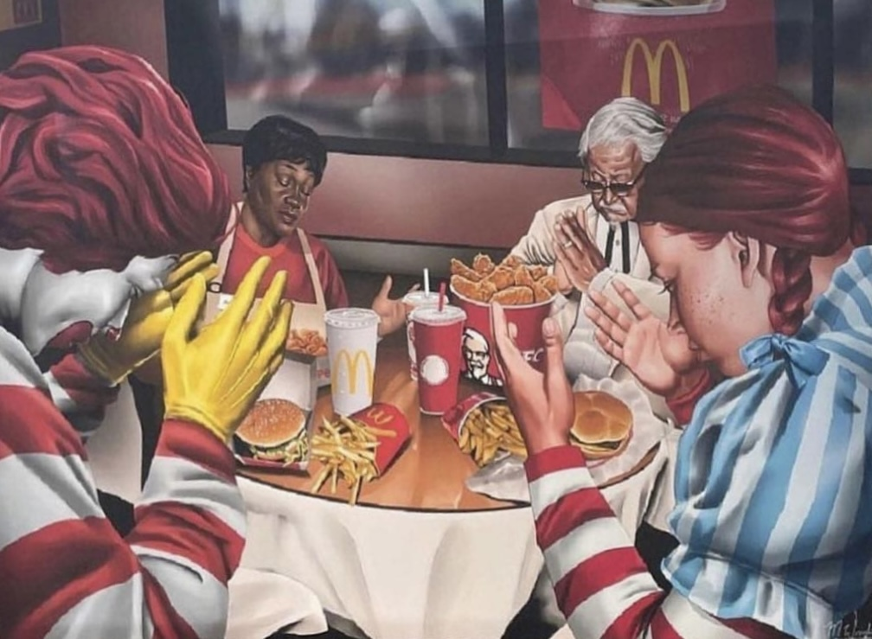
Thanks for spending time listening to what I had to say y’all! I need more money for college please and V-Bucks.

